Slide 1

MODULE 1
Introduction to Programming
& Python
Goal: Understand what programming is — before writing complex code.
CSE • First Year • Beginner Friendly
HCLTech Career Shaper™

Slide 2

THE BASICS
What Is a Computer Program?
A computer program is a set of step-by-step instructions that tells a computer exactly what to do.
Everyday Analogy: A Recipe
Computers cannot think on their own — they only follow instructions.
Each instruction must be precise, clear, and in the correct order.
A program can be as small as one line, or millions of lines long.
1
A recipe gives exact steps to cook a dish.
2
A program gives exact steps to solve a problem.
3
Skip a step or get the order wrong — the result breaks.
4
Follow it correctly — you get the expected output, every time.
Module 1 • Introduction to Programming & Python
2

Slide 3

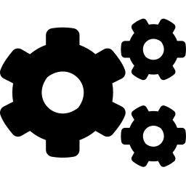


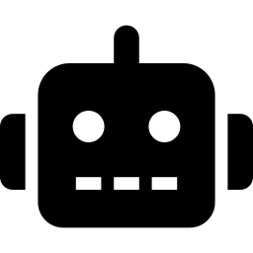
THE BASICS
Why Do We Learn Programming?
Programming helps us solve real problems using computers.
Real-Life Example
PROGRAMMING ALLOWS US TO
Automate repetitive tasks
1
A company receives 10,000 customer records every single day.
Build applications
Analyze data
2
Checking each one manually would take a team hours, or days.
Create websites
3
A program can read, check, and process all of them automatically — in seconds.
Develop AI systems
Module 1 • Introduction to Programming & Python
3

Slide 4


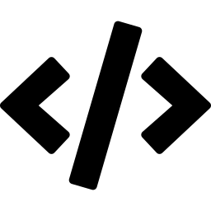

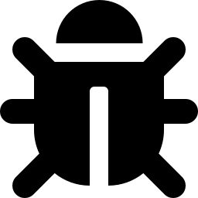

THE BASICS
What Is Programming?
Programming is the process of writing, testing, and fixing instructions (code) that tell a computer how to solve a problem.
1
2
3
4
5
Analyze the
Problem
Design a
Solution
Write the
Code
Test It
Thoroughly
Debug &
Improve
Module 1 • Introduction to Programming & Python
4

Slide 5

THE BASICS
What Is an Algorithm?
An algorithm is a step-by-step procedure to solve a problem — it explains the logic of a solution before any code is written.
Real-Life Example: Making Tea
A GOOD ALGORITHM IS
1
Boil water
Made of clear steps
2
Add tea leaves
Finite — it must end
3
Add sugar
In a logical order
4
Add milk
Easy to understand
5
Boil for 2 minutes
6
Pour into a cup
Module 1 • Introduction to Programming & Python
5

Slide 6

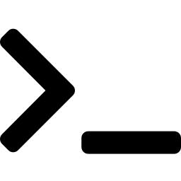

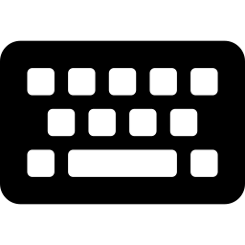


COMPUTER FUNDAMENTALS
Operating System (OS)
An OS acts as a bridge between the user and the hardware. Without an OS, a computer cannot run any applications.
EXAMPLES OF OPERATING SYSTEMS
FUNCTIONS OF AN OS
Windows
Manages the CPU
Linux
Manages memory
macOS
Controls input/output devices
Android
Runs applications
Provides the user interface
iOS
Module 1 • Introduction to Programming & Python
6

Slide 7
COMPUTER FUNDAMENTALS
GUI and CLI
Users interact with computers using an interface — there are two main types: GUI and CLI.
GUI (Graphical UI)
CLI (Command Line)
Uses icons, buttons, and windows
Easy for beginners
Mouse and keyboard are used
Examples: Windows OS, macOS, Ubuntu Desktop
Users type commands using the keyboard
Faster for advanced users
Used by programmers & system admins
Examples: Linux Terminal, Command Prompt, PowerShell
Real-life example: Clicking folders and opening files on Windows Desktop.
Module 1 • Introduction to Programming & Python
7

Slide 8
THE BASICS
Programming Languages
A programming language is a set of rules and vocabulary used to write instructions that a computer can understand and carry out.
LOW-LEVEL
HIGH-LEVEL
Closer to machine (binary) code. Hard for humans to read, but very fast and hardware-specific.
Closer to human language. Easy to read, write, and learn — used for most modern software.
EXAMPLES
EXAMPLES
Machine Language
Assembly Language
Python • Java
C++ • JavaScript
Module 1 • Introduction to Programming & Python
8

Slide 9


THE BASICS
How Computers Execute Programs
Computers cannot understand human language — they only understand machine language (binary). So every program is converted before it runs.
1
2
3
4
Programmer
Writes Code
Code Converted to
Machine Language
CPU Executes
Instructions
Output Is
Produced
Types of Translators: Compiler & Interpreter — Python uses an Interpreter.
Real-life analogy: You speak English → a translator converts it → the other person understands.
Module 1 • Introduction to Programming & Python
9

Slide 10
THE BASICS
Compiler vs. Interpreter
Both translate human-readable code into instructions a computer can run — but they work differently.
Compiler
Interpreter
Translates the entire program at once, before running it.
Creates a separate machine-code file.
Faster execution; errors shown all together.
Used by C, C++.
Translates and runs code line-by-line.
No separate file is created.
Easier to debug; stops at the first error.
Used by Python.
Module 1 • Introduction to Programming & Python
10

Slide 11

THE BASICS
What Is an Interpreter?
An interpreter is a program that executes code line by line. It reads one line, converts it to machine instructions, executes it, then moves to the next.
Analogy: Google Translate
Person A speaks English, Person B understands only Hindi — so they use Google Translate.
“An interpreter translates and executes code
one line at a time.”
1
Person A speaks one sentence in English.
2
Google Translate immediately converts that sentence to Hindi.
Just like Google Translate converts one sentence at a time, an interpreter executes program code one line at a time.
3
Person B understands the translated sentence.
4
Then the next sentence is translated — one at a time.
Module 1 • Introduction to Programming & Python
11

Slide 12
MEET THE LANGUAGE
What Is Python?
Python is a high-level, general-purpose, interpreted programming language, created by Guido van Rossum and first released in 1991.
# my_first_look.py
name = "CSE Student"
print("Hello, " + name)
print("Welcome to Python!")
# Output:
# Hello, CSE Student
# Welcome to Python!
Reads almost like plain English.
One of the most beginner-friendly languages to start with.
Same code runs on Windows, macOS, and Linux.
Module 1 • Introduction to Programming & Python
12

Slide 13

MEET THE LANGUAGE
Features & Applications of Python
KEY FEATURES
REAL-WORLD APPLICATIONS
Simple, readable syntax
Web development
Interpreted language
Data science & analytics
Dynamically typed
Artificial intelligence & ML
Free & open source
Automation & scripting
Huge library support
Game development
Module 1 • Introduction to Programming & Python
13

Slide 14

GETTING SET UP
Installing Python
1
2
3
4
Visit python.org
Download the installer
Run & check the PATH box
Verify the install
Go to python.org/downloads in your browser.
Choose the latest version for your operating system.
During setup, tick “Add Python to PATH” — very important!
Open a terminal/command prompt and type: python --version
Module 1 • Introduction to Programming & Python
14

Slide 15
GETTING SET UP
Python IDEs (Code Editors)
An IDE (Integrated Development Environment) is where you write, run, and debug your code.
IDLE
VS Code
Jupyter Notebook
Comes built-in with Python. Simple and minimal — nothing extra to install.
A free, powerful, and highly customizable code editor with extensions.
Runs code in cells with instant output — great for experimenting.
Best for absolute beginners
Best for everyday coding
Best for data & learning
Module 1 • Introduction to Programming & Python
15

Slide 16
WRITING CODE
Running Your First Python Program
Open your IDE (e.g. IDLE or VS Code).
Create a new file and save it as hello.py
Type the single line of code shown on the right.
Run the file (Run → Run Module, or press F5).
See the output appear in the console below.
hello.py
print("Hello, World!")
OUTPUT
Hello, World!
Module 1 • Introduction to Programming & Python
16

Slide 17
WRITING CODE
The print() Function
print() is a built-in function used to display output — text, numbers, or results — on the screen.
# Printing text
print("Hello, World!")
# Printing numbers / math
print(5 + 3)
# Printing multiple items
print("Age:", 19)
# Output
Hello, World!
8
Age: 19
Anything typed inside quotes is called a string.
You can print numbers, math results, or several items at once.
Each print() statement moves to a new line by default.
Module 1 • Introduction to Programming & Python
17

Slide 18
WRITING CODE
Comments in Python
Comments are notes in your code that Python completely ignores when running. They exist purely to help humans understand the code.
# This is a single-line comment
print("Comments are ignored")
x = 10 # comment after code
"""
This is a multi-line comment.
Great for longer explanations.
"""
print("Code continues here")
WHY USE COMMENTS?
Explain what tricky code does
Leave notes for teammates (or future you)
Temporarily “switch off” a line while testing
Module 1 • Introduction to Programming & Python
18

Slide 19
WRITING CODE
Python Syntax & Indentation
Unlike many languages, Python uses indentation (spacing) — not curly braces { } or semicolons — to define blocks of code.
Correct Indentation
Incorrect Indentation
age = 20
if age >= 18:
print("You are an adult")
print("You can vote")
# 4 spaces = one indent level
age = 20
if age >= 18:
print("You are an adult")
# IndentationError:
# expected an indented block
Module 1 • Introduction to Programming & Python
19

Slide 20
WRITING CODE
Basic Errors & Debugging
Syntax Error
Runtime Error
Logical Error
Broken grammar — code that doesn't follow Python's rules.
Code is valid, but crashes while running.
Code runs fine, but gives the wrong result.
print("Hi"
10 / 0
area = l + w # should be l * w
HOW TO DEBUG
1. Read the error message & line number carefully
2. Check indentation, quotes & brackets
3. Use print() to trace variable values
4. Fix one error at a time, then re-run
Module 1 • Introduction to Programming & Python
20

Slide 21
You're Ready to Start Coding!
You now know how computers, operating systems, and programs work — and how to write, run, and debug simple Python code.
NEXT UP: MODULE 2 — VARIABLES & DATA TYPES
Thank You
HCLTech Career Shaper™ • Supercharging Progress™

